Slide 1
Deliverance Exodus 1-12

Slide 2
Joseph and his generation died
Israelites in Egypt as slaves for 400 years
Much oppression

Slide 3
I was raised as Pharaoh’s daughters son
I killed an Egyptian

Slide 4
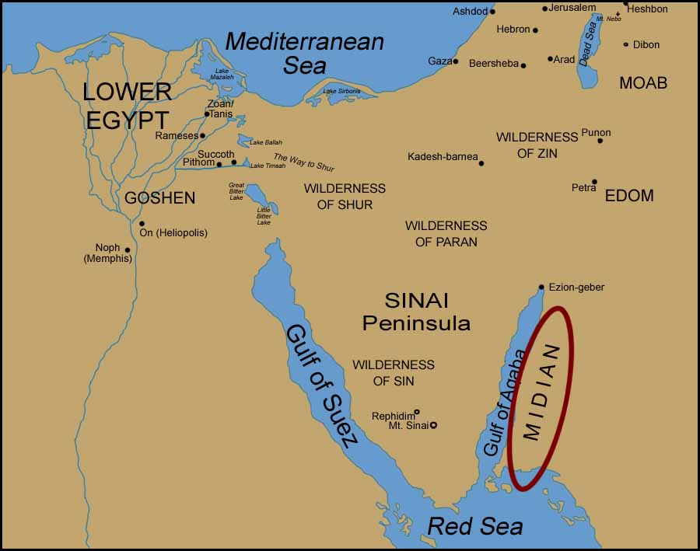
I fled to Midian

Slide 5
I met and married a shepherd’s daughter.

Slide 6
Working with father in law and the sheep.
Notes:
Wait for Dave to introduce

Slide 7
God spoke to me out of the burning bush

Slide 8
Great news; God is going to deliver His people!
God says to me, ‘so now go, I am SENDING YOU to Pharaoh to bring my people the Israelites out of Egypt’
(not great news)

Slide 9
God says, 'I will be with you’
God says, ‘Tell them I AM who I AM. Tell them I AM has sent me to you.’

Slide 10
I put forward my best arguments as to why I should not do the job.
Finally I obeyed God, went, met Aaron and went to tell the Hebrew people the good news
Pharaoh is not happy

Slide 11
The plagues
God reveals He is the Almighty, the most powerful God.

Slide 12
The Passover

Slide 13
John 1:29 “Behold, the lamb of God who takes away the sin of the world.”
1 Corinthians 5:7, “For Christ, our Passover lamb, has been sacrificed.”

